Slide 1


Slide 2

ROBOTICS

Slide 3
Overview
What is Robotics?
Robot Locomotion
Computer Vision
Components
Applications of Robotics

Slide 4
What Is Robots?
Robotics is a domain in artiﬁcial intelligence that deals with the study of creating intelligent and eﬃcient robots.
Robotics is a branch of AI, which is composed of Electrical Engineering, Mechanical Engineering, and Computer Science for designing, construction, and application of robots.

Slide 5
Aspects of Robotics
The robots have mechanical construction, form, or shape designed to accomplish a particular task.
They have electrical components which power and control the machinery.
They contain some level of computer program that determines what, when and how a robot does something.

Slide 6
Difference in Robot System and Other AI Program
AI Programs | Robots
They usually operate in computer-stimulated worlds. | They operate in real physical world
The input to an AI program is in symbols and rules. | Inputs to robots is analog signal in the form of speech waveform or images
They need general purpose computers to operate on. | They need special hardware with sensors and effectors.

Slide 7

Robot Locomotion

Slide 8
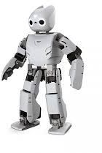
Robot Locomotion
Locomotion is the method of moving from one place to another.
The mechanism that makes a robot capable of moving in its environment is called as robot locomotion.

Slide 9
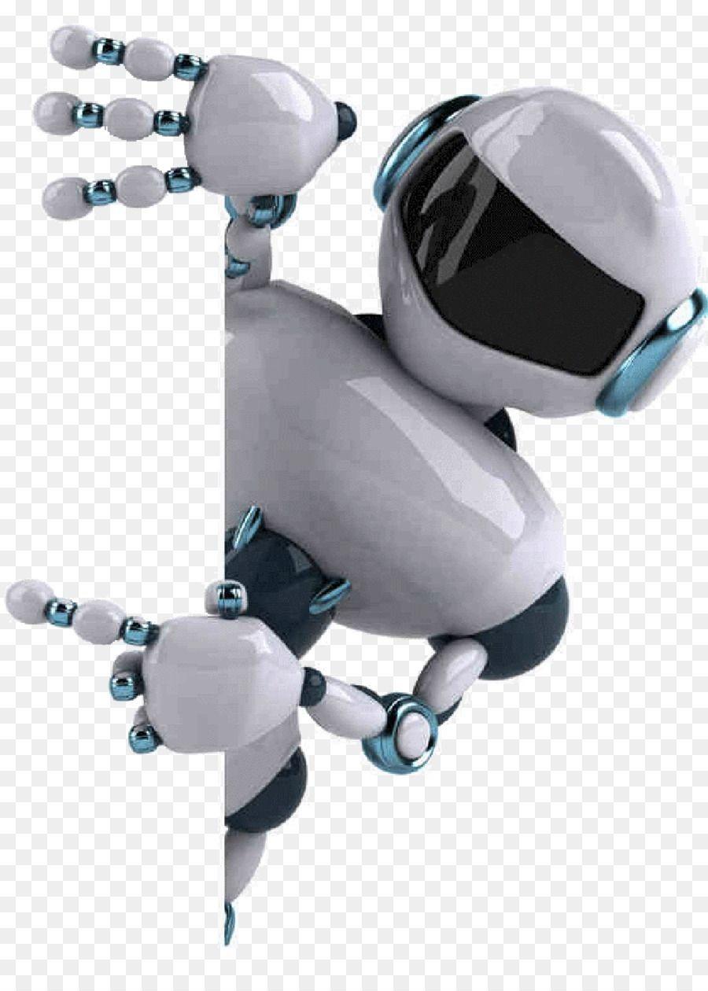
Types of locomotion
Legged
Wheeled
Combination of Legged and Wheeled
Tracked slip/skid

Slide 10
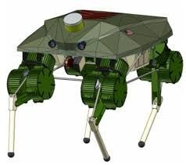
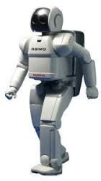
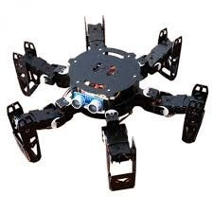
Legged locomotion
This type of locomotion consumes more power while demonstrating walk, jump, hop, climb up or down, etc.
It requires more number of motors to accomplish a movement.
It comes with the variety of one, two, four, and six legs.

Slide 11
Legged locomotion
If a robot has k legs, then the number of possible events N = (2k-1)!
In case of a two-legged robot (k=2), the number of possible events is N = (2k-1)! = (2*2-1)! = 3! = 6.
Hence there are six possible diﬀerent events
Lifting the Left leg
Releasing the Left leg
Lifting the Right leg
Releasing the Right leg
Lifting both the legs together
Releasing both the legs together

Slide 12
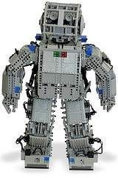
Legged locomotion
In case of k=6 legs, there are
39916800 possible events.
Hence the complexity of robots is directly proportional to the number of legs.

Slide 13
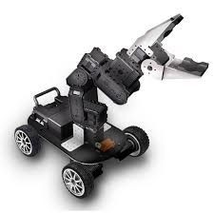
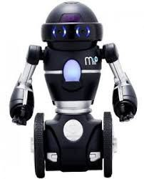
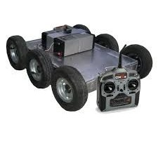
Wheeled locomotion
It requires fewer number of motors to accomplish a movement.
It is little easy to implement as there are les stability issues in case of more number of wheels.
It is power eﬃcient as compared to legged locomotion.
s

Slide 14
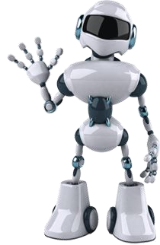
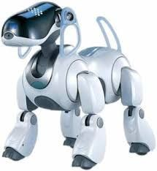
Combination of legged & wheeled
Both the legged and the wheeled locomotion technique is used

Slide 15
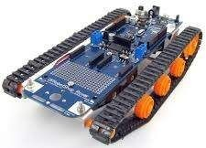
Slip/Skid Locomotion
In this type, the vehicles use tracks.
The robot is steered by moving the tracks with different speeds in the same or opposite direction.
It offers stability because of large contact area of track and ground.

Slide 16
Computer Vision
Technology of AI with which the robots can see.
Computer vision automatically extracts, analyzes, and comprehends useful information from a single image or an array of images.

Slide 17
Tasks & Applications of Computer vision
OCR
FACE DETECTION
OBJECT RECOGNITION
ESTIMATING POSITION
APPLICATIONS
Agriculture
Biometrics
Robotics

Slide 18
Components of Robotics
Manipulator
Endeffector
The Locomotion Device
The Controller
The Sensors

Slide 19
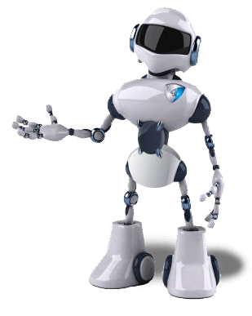

Applications Of Robotics

Slide 20
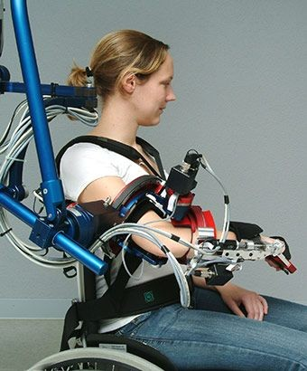
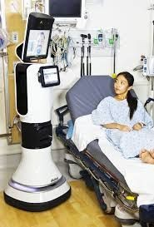

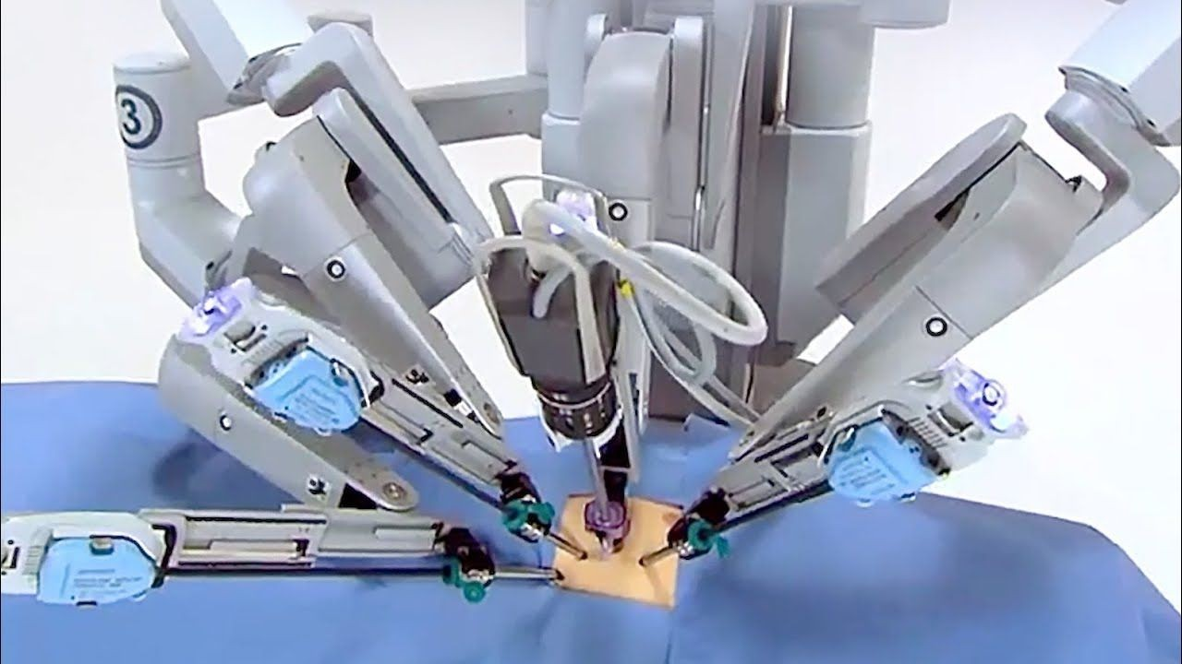
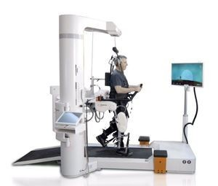
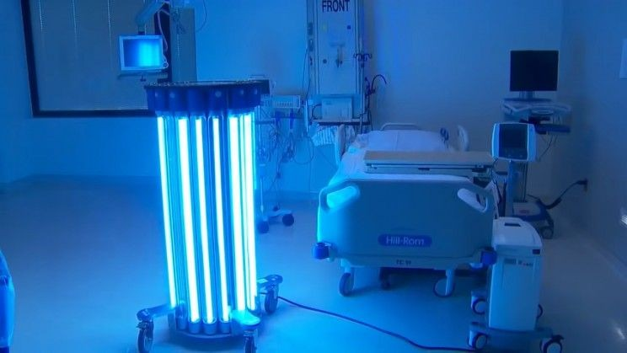
Medical Robot in Hospital
A medical robot is a robot used in the medical science.
Surgical Assistance
Medical transportation Robot
Sanitation and Disinfection Robots
Telepresence
Rehabilitation

Slide 21
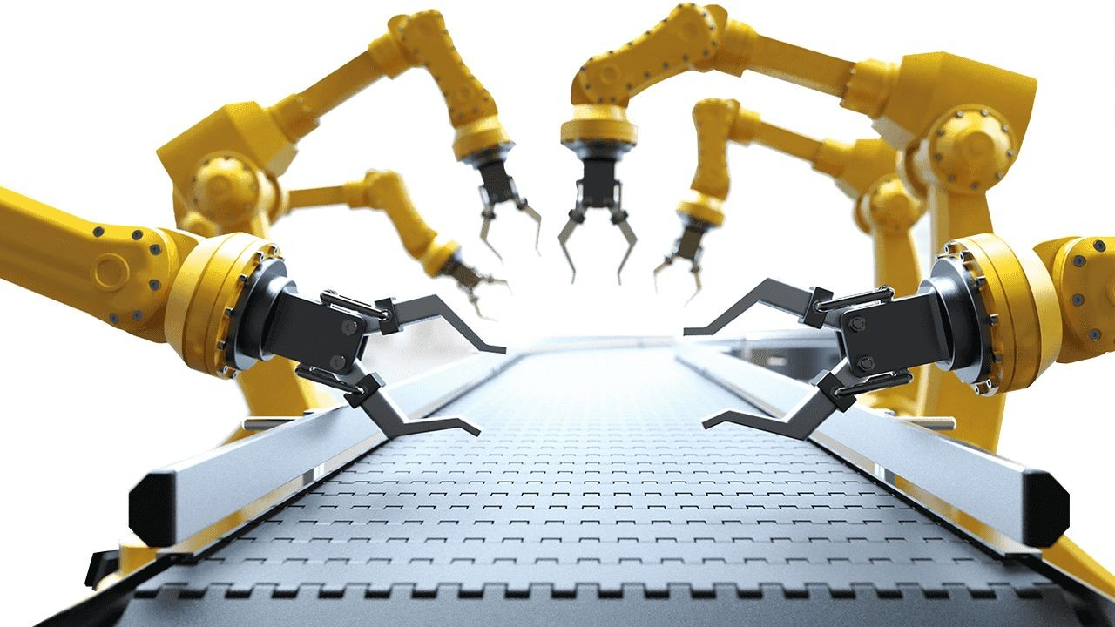
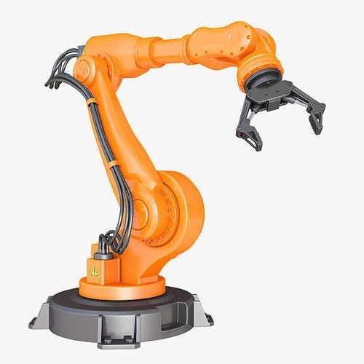
Industrial Application
❏ Material handling
❏ Material transfer
❏ Machine loading and unloading
❏ Spot welding
❏ Continuous arc welding
❏ Spray coating

Slide 22
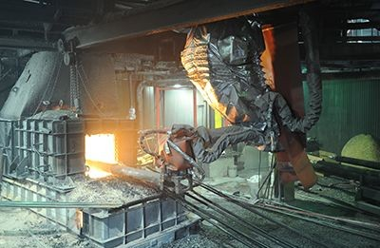
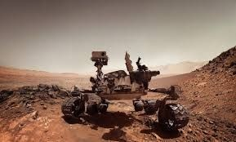
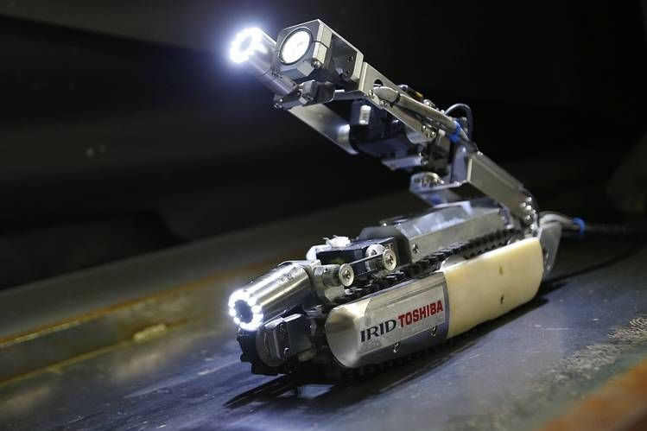
Robots in Hazardous environment
The hazardous environment can be deﬁne the place where human can not survive and harmful. Some examples of hazardous environments would be nuclear reactors, outside earth’s atmosphere and even behind enemy
lines in war.

Slide 23
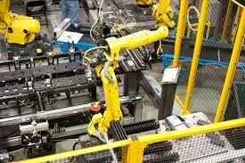
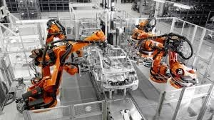
Automobiles application
Robotics are Advancing automobile manufacturing to new heights. Robots givesautomotive companies a competitive advantage .
Robotic Painting
Robotic Welding
Robotic Assembly
Material Removal

Slide 24
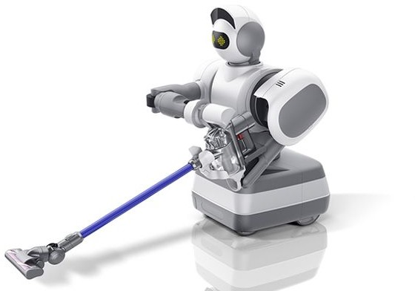
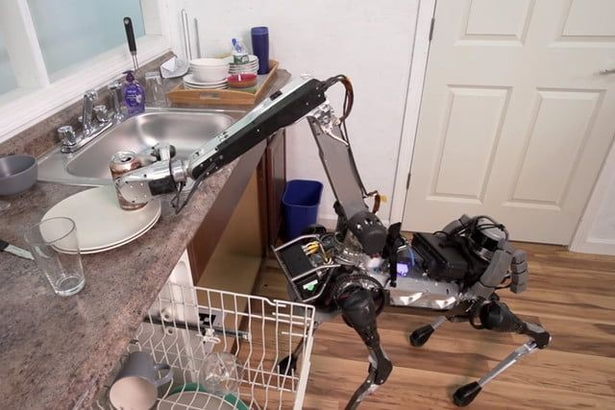
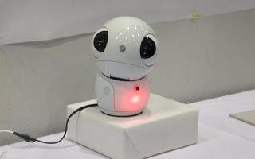
Household purpose application
A domestic robot is a type of service robot, an autonomous robot that is used for household chores .

Slide 25
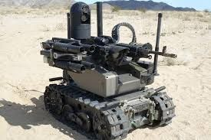
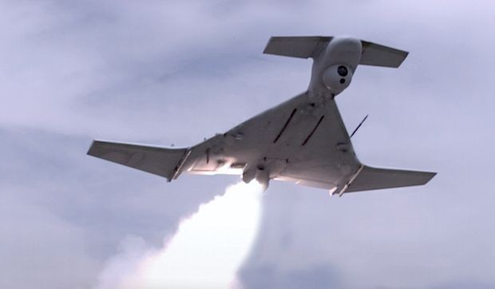
Military Application
Military robots autonomous robots or remote-controlled mobile robots designed for military applications from transport to search & attack.

Slide 26
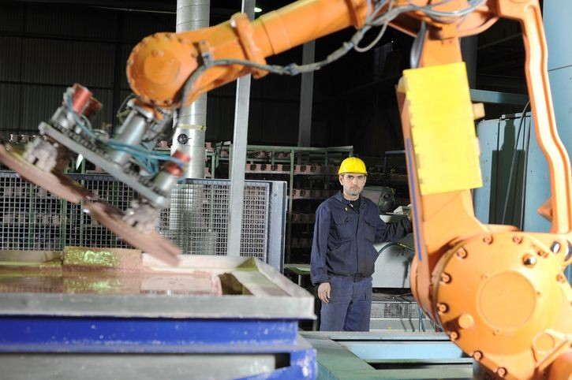
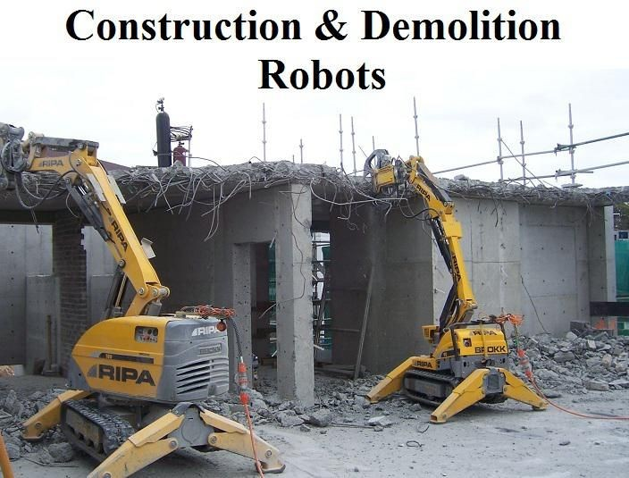
Construction application
The construction industry slightly depends on robot. Robots can reduce the breakneck phenomenon such as metal dissolve , piling etc.

Slide 27
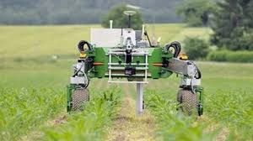
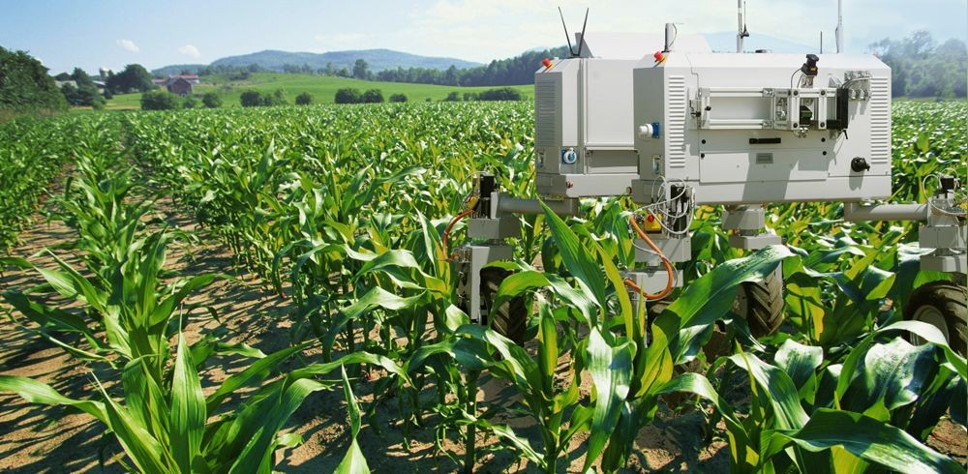
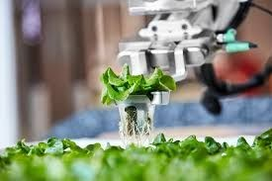
Agricultural Application
Agricultural robots is a robot deployed for agricultural purposes. The main area of application of robots in agriculture today is at the harvesting stage.

Slide 28
THANK YOU PRESENTED BY:- M.ABDUL RAOUF(21071A7242)

